Slide 1


Online Streaming platform
FuGenX

Slide 2
Table of contents
2
1
3
4
6
5
Introduction
Problem
Statement
Objectives
Analysis
Testing
Final Demo

Slide 3


The Introduction
What are online streaming platforms?
A video streaming service is an on demand online entertainment source for TV shows, movies and other streaming media.
High-Quality Streams.
Greater Audience Potential.
Wide Variety of Content Use.
Ease and Convenience.

Slide 4

Streaming refers to any media content – live or recorded – delivered to computers and mobile devices via the internet and played back in real time.
Podcasts, webcasts, movies, TV shows and music videos are common forms of streaming content.
These services provide an alternative to cable and satellite on demand service, often at a lower cost. Use of streaming services often requires fees, either per view or subscription.

Slide 5
Problem Statement
In recent years, the Web has undergone a tremendous growth regarding both content and users. This has led to an information overload problem in which people are finding it increasingly difficult to locate the right information at the right time.
This abstract studies the feasibility of the integration of a recommender engine as a module to the online streaming platform.
It mines movie databases to collect all the important information, such as, popularity and attractiveness, required for recommendation.
It generates movie swarms not only convenient for movie producers to plan a new movie but also useful for movie recommendation.

Slide 6
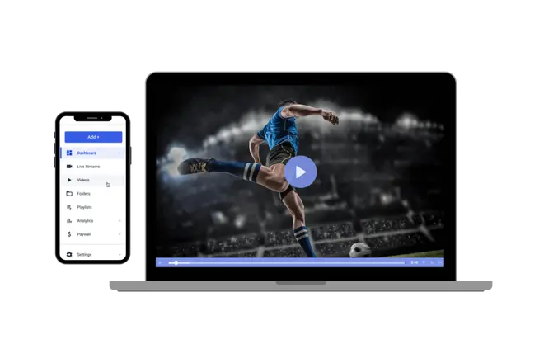

Objectives
1. High-Quality Streams
Online streaming service with a robust infrastructure and a good content delivery network (CDN) to achieve high-quality video.
2. Greater Audience Potential
Online streaming, however, you can invite as many people as you like to “come Together”.Online streaming your event can make your content accessible to these people whom you wouldn’t reach otherwise.

Slide 7


3. Ease and Convenience
Online streaming can be very simple. All you need are relevant video and audio equipment, an internet connection, an encoder, and a trusty streaming platform.
4. Customer Support
Watching Movies on your own, your only support will be Google or the information you already know about Online streaming. A reliable Online streaming service will provide you with ongoing customer support and will guide you through any difficulties you encounter. When streaming Movies, you need a live support team by your side.

Slide 8
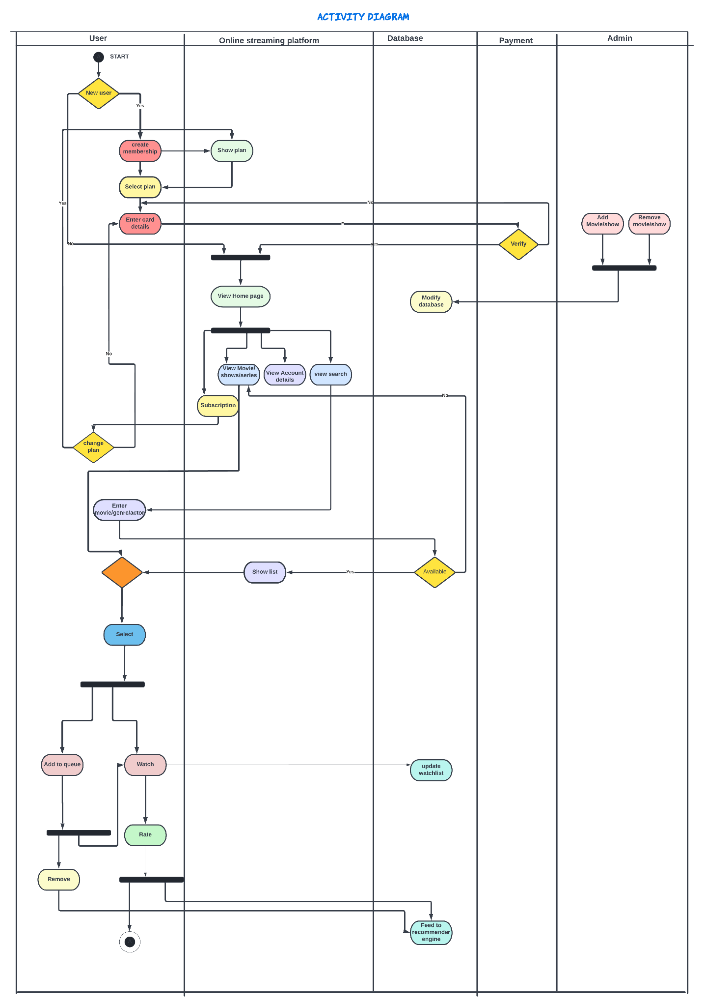
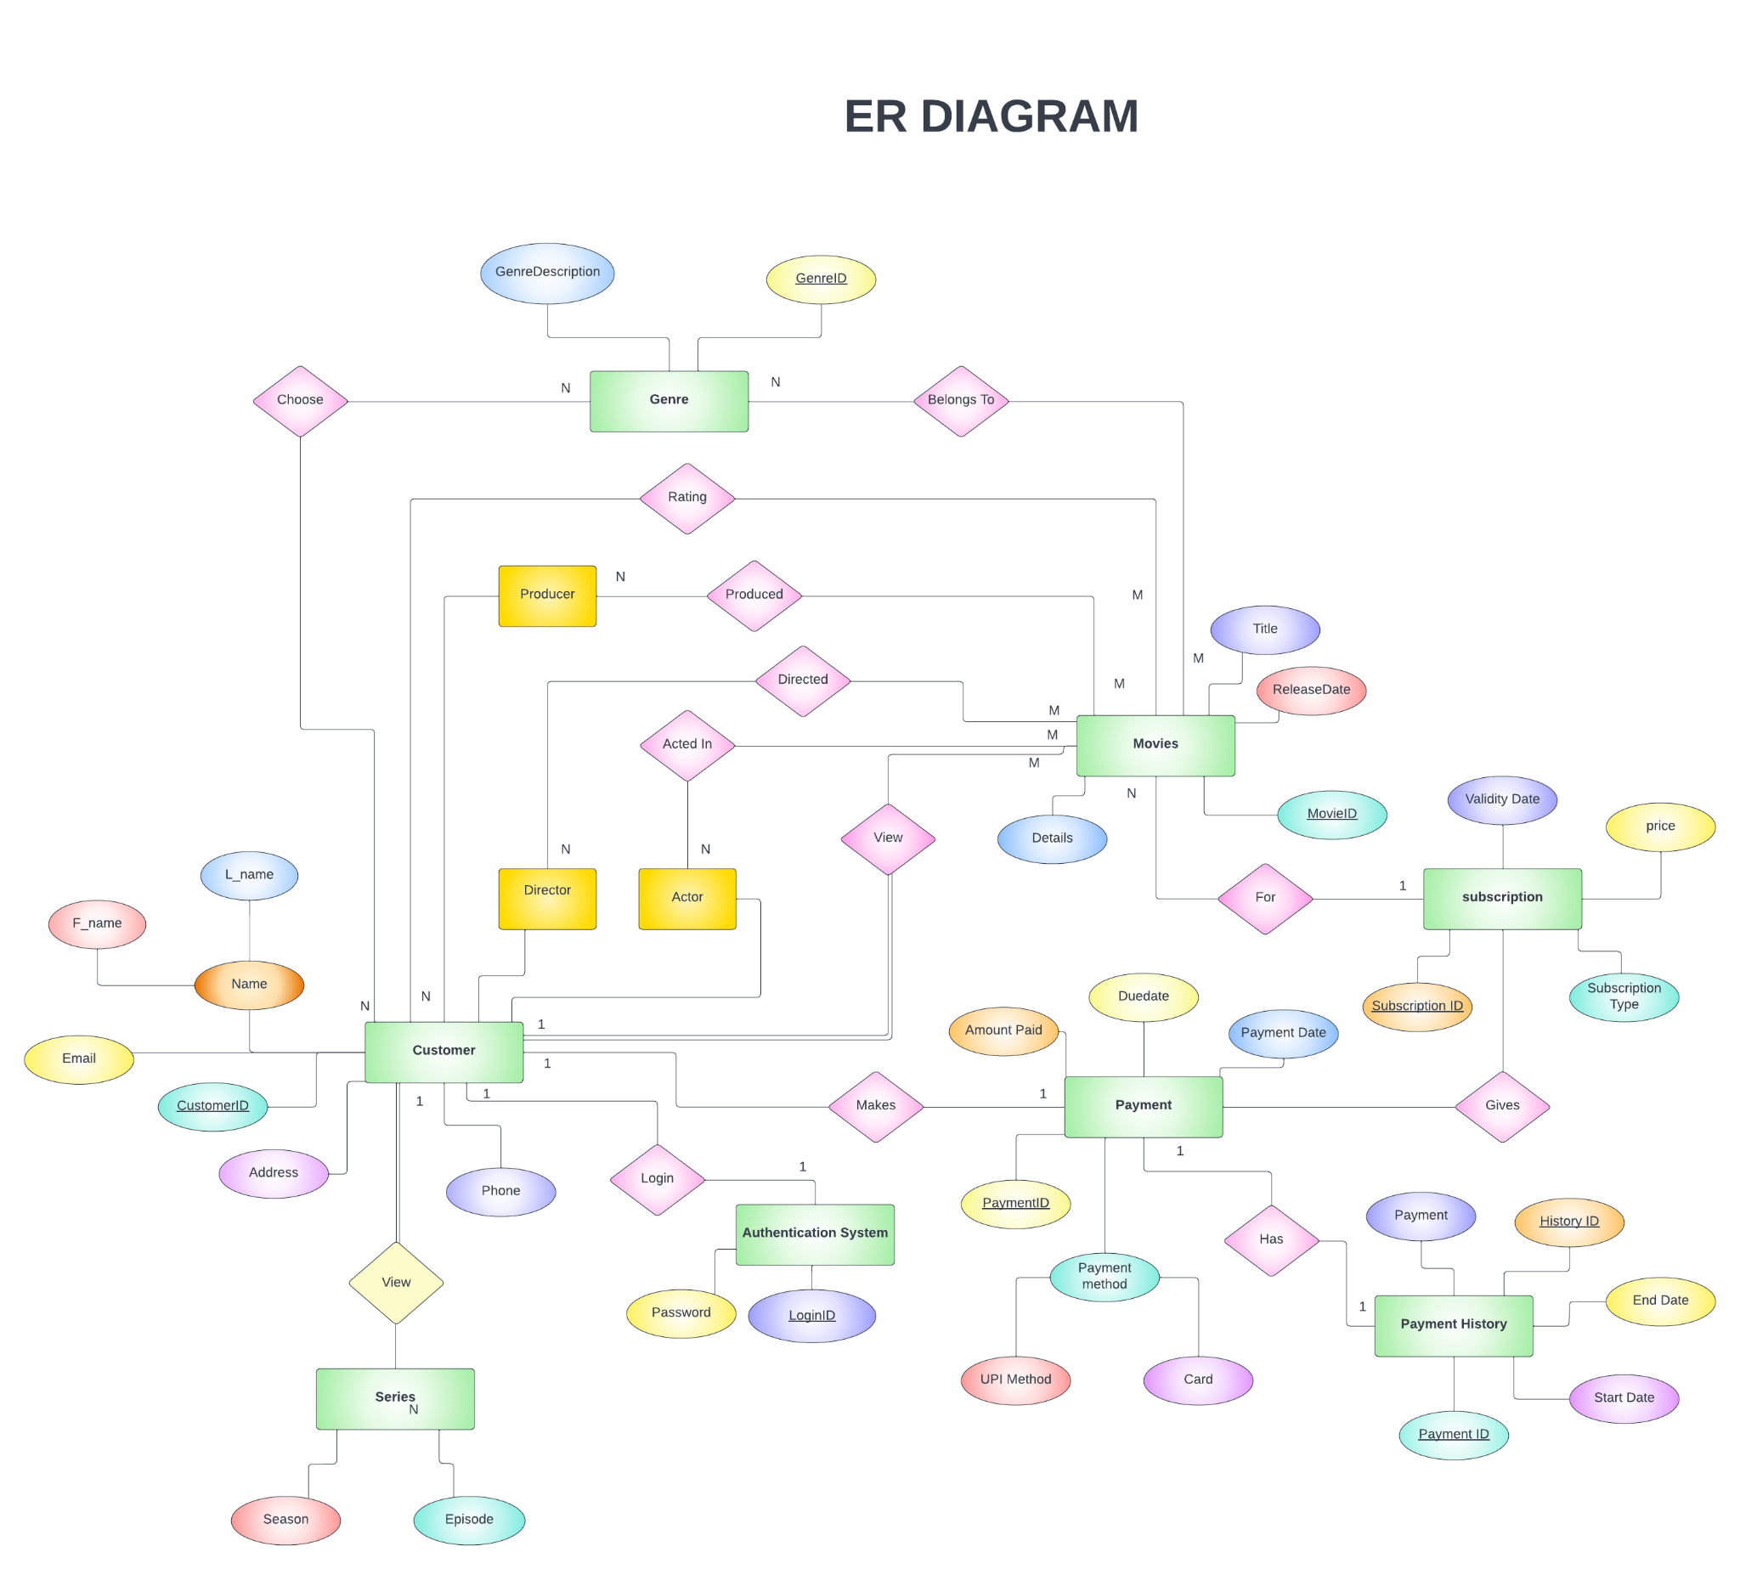
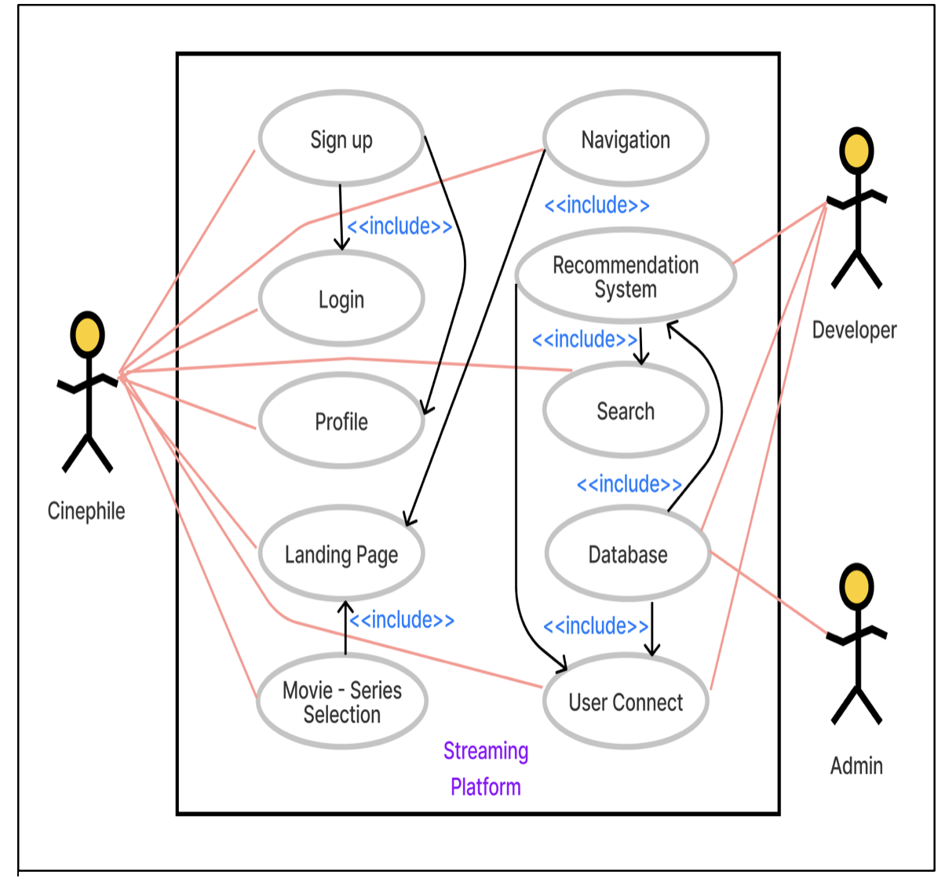
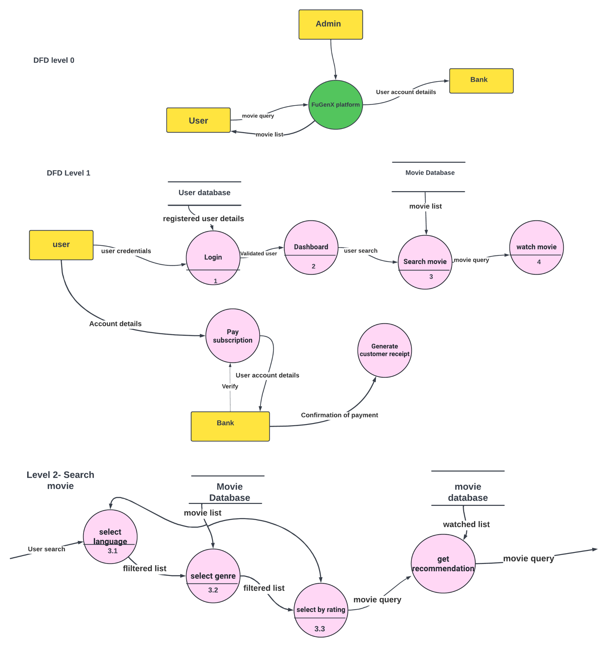
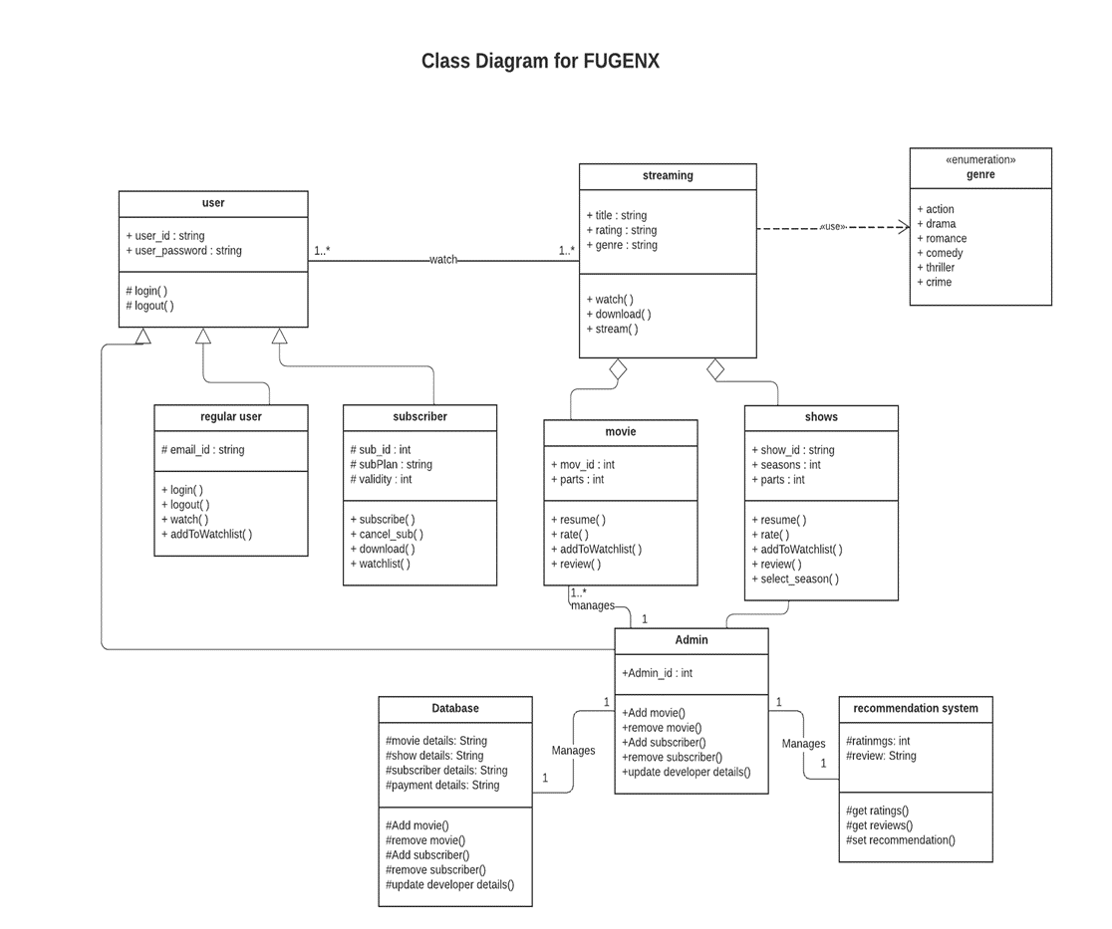
My position
Analysis

Slide 9
Use case diagram

Slide 10
ER Diagram

Slide 11
Activity Diagram

Slide 12
Class Diagram

Slide 13
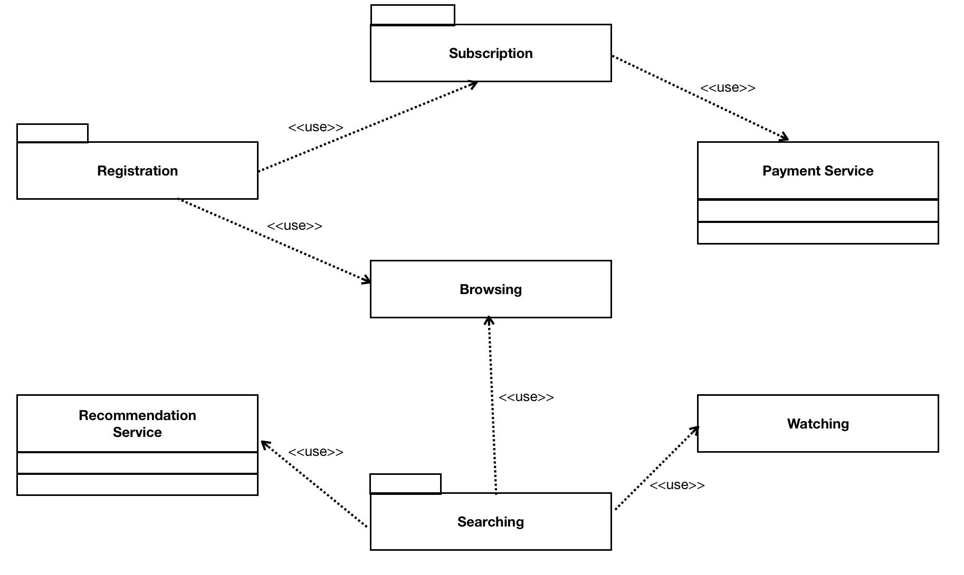
Component diagram

Slide 14
Data flow Diagram

Slide 15
Testing
Testing LogIn Authentication
Testing SignIn and SignUp
Movie Search
Recommendation System Check
Sign Out
DataBase Check

Slide 16

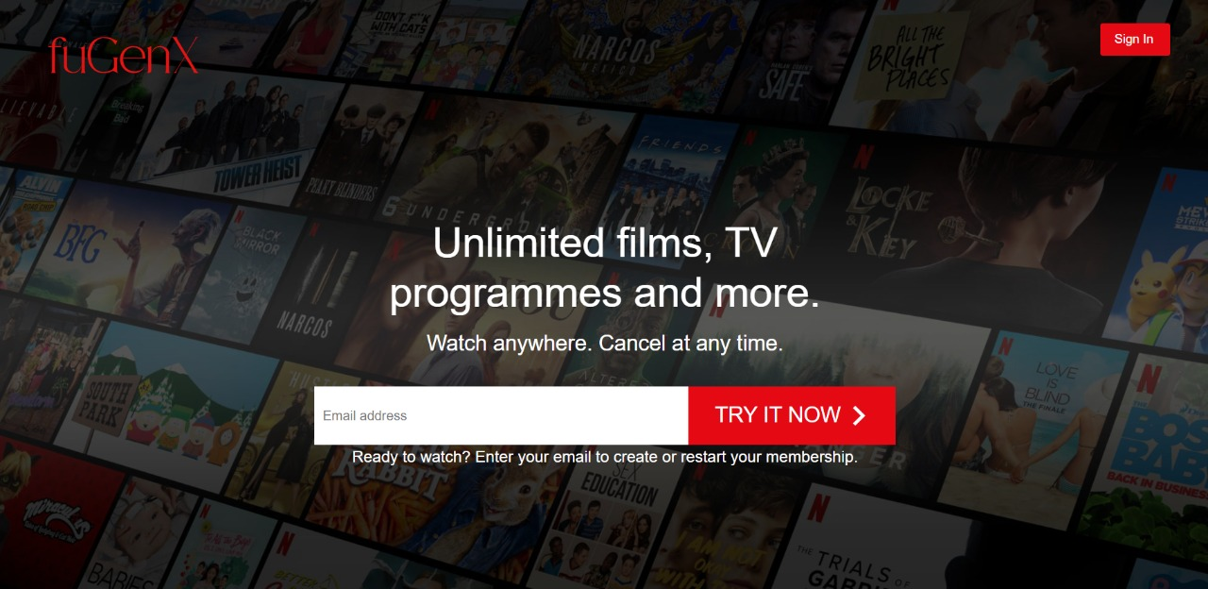
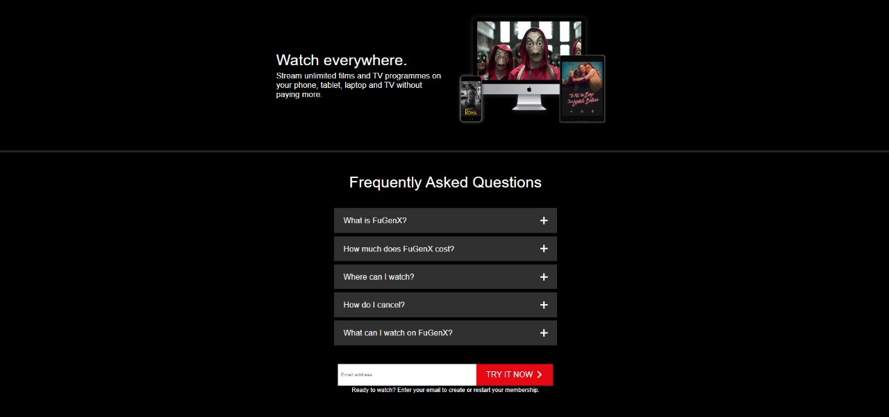
Final Demo

Slide 17
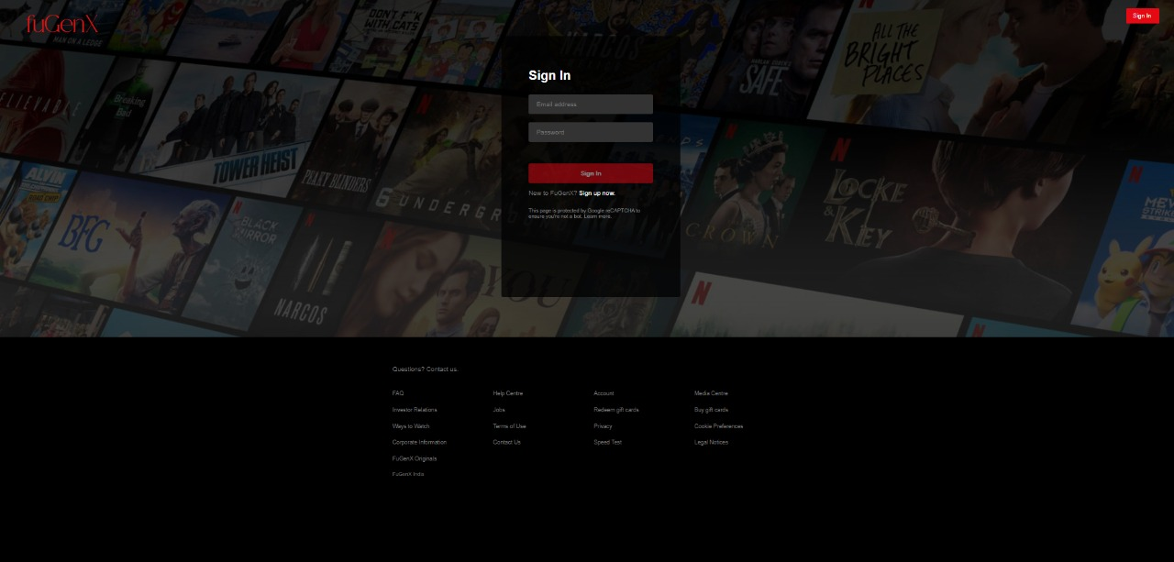
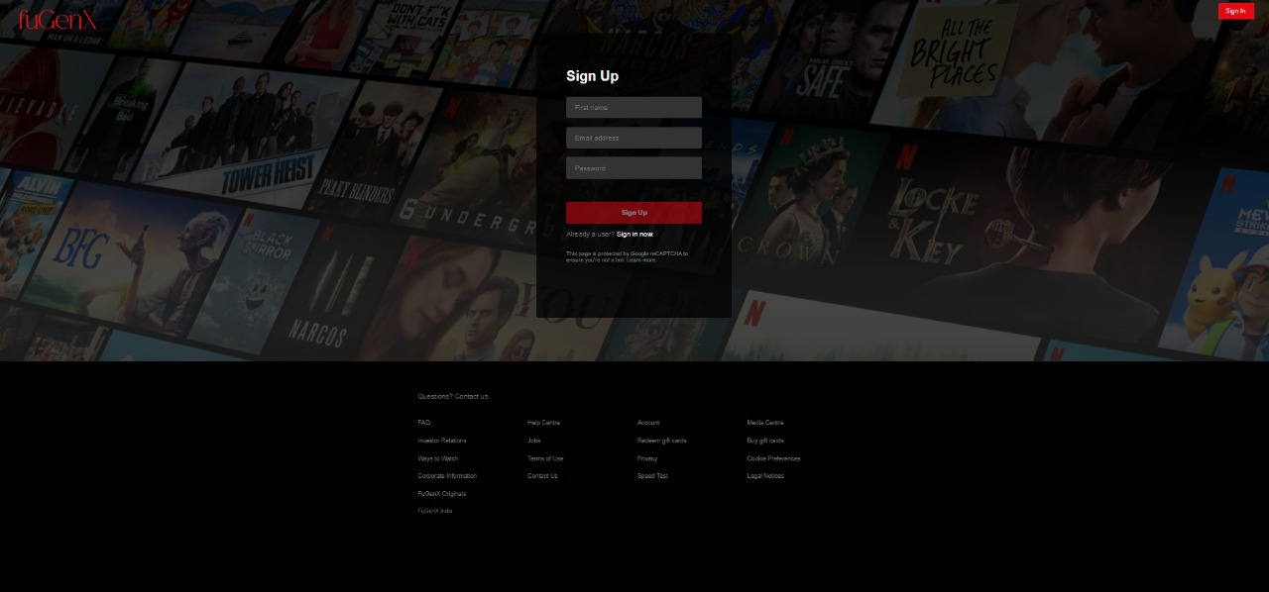
Sign In
Sign Up

Slide 18
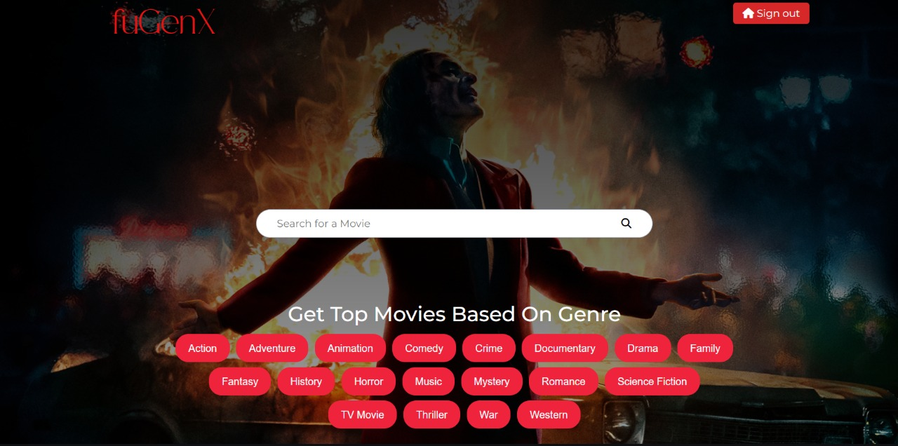
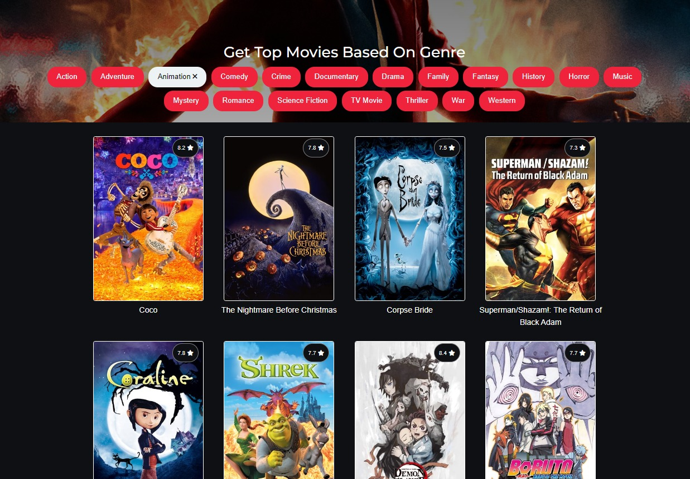

Slide 19
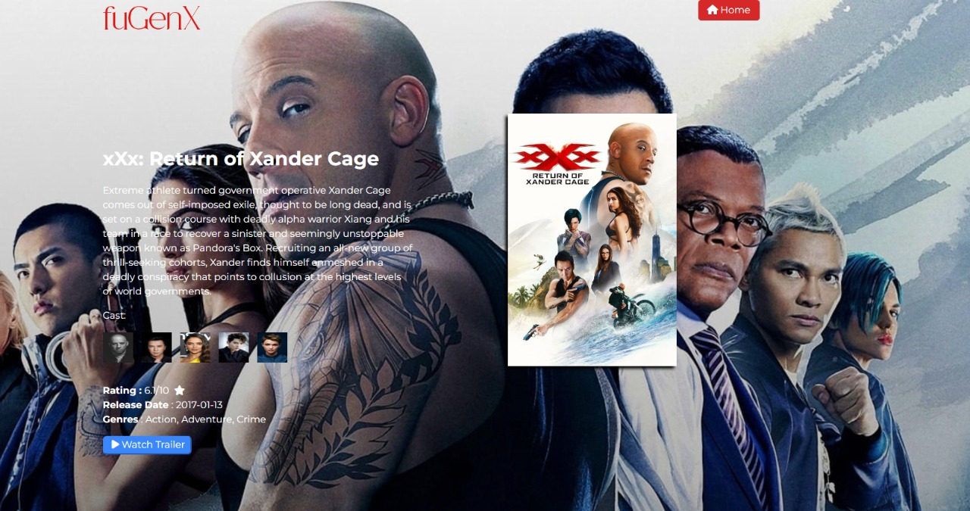
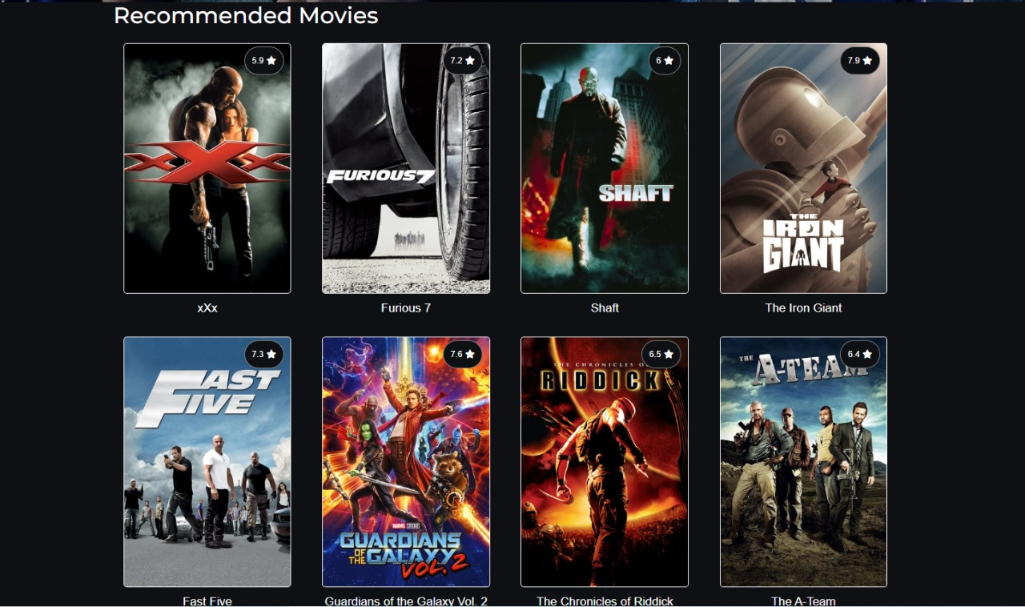

Slide 20
Thanks
20Z316- Diyaa Santhosh
20Z325- Kavin Aravindhan R
20Z327- Lakshmi Priyadarshini M
20Z355- Yadav Ranganathan
20Z367- Hardik P

